Slide 1

FOREST FIRE PREDICTION
Nithin Kumar Allam
XU43419
Prepared for: UMBC
Data Science Master Degree Capstone by Dr. Chaojie (Jay) Wang

Slide 2

Introduction
Forest fires pose significant threats to environmental conservation and human safety.
Uncontrolled wildfires can lead to extensive damage to ecosystems, loss of biodiversity, destruction of habitats, and endangerment of human communities.
Predicting forest fires accurately is crucial for implementing proactive measures to mitigate these risks and minimize their impact

Slide 3
Research Questions:
What environmental and weather factors are most influential in predicting forest fires?
How can machine learning algorithms effectively model the complex relationships between environmental variables and fire occurrences?
How do different machine learning algorithms compare in terms of predictive accuracy for forest fire prediction?

Slide 4

Data
Data source: Algerian Forest Fires from UCI
Data size: 12.9 KB
Time period: The datasets cover a time span of (from 06/01/2012 to 09/30/2012).
What does each row represent?
The dataset includes 244 instances that regroup a data of two regions of Algeria, namely the Bejaia region located in the northeast of Algeria and the Sidi Bel-abbes region located in the northwest of Algeria

Slide 5

Features/Predictors
Temperature
relative humidity (RH),
wind speed (Ws),
rainfall (Rain),
Fire Weather Index (FWI),
Fuel moisture code (FFMC),
Duff moisture code (DMC),
Initial Spread index (ISI),

Slide 6

Machine learning
Classification: In our Forest Fire Prediction System, the task at hand is binary classification, where the dependent feature is whether a scenario results in a fire or not. This binary classification is crucial for providing actionable insights to forest management agencies and emergency responders.

Slide 7
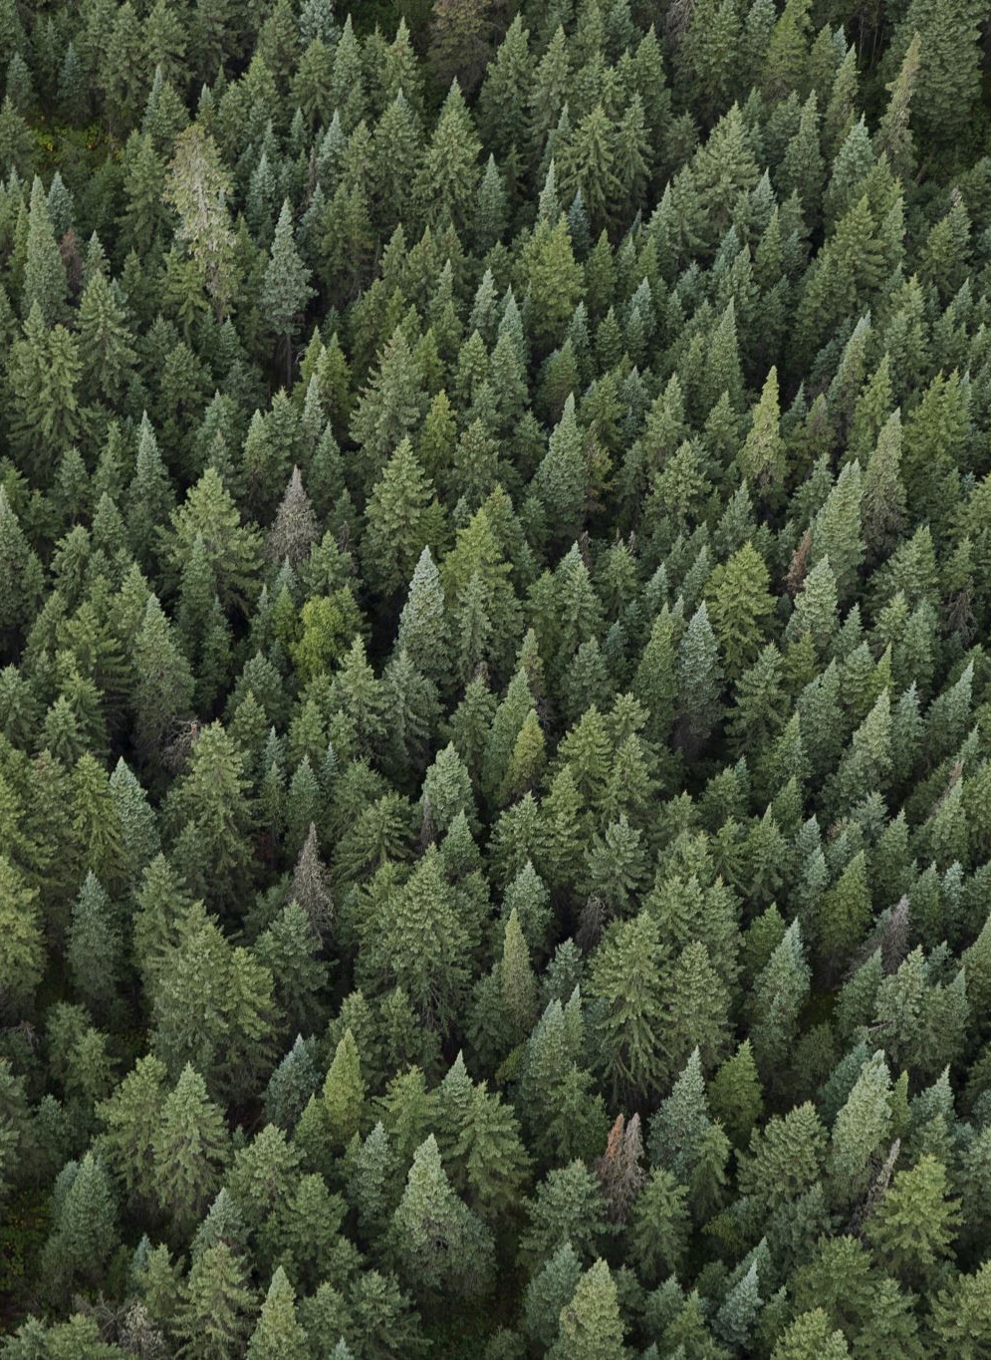
Models
Random Forest: Random Forest is an ensemble learning method that operates by constructing a multitude of decision trees during training and outputting the class that is the mode of the classes of the individual trees.
XGBoost: XGBoost is an implementation of gradient boosting machines that has shown significant success in various machine learning competitions.
Comparison: Both Random Forest and XGBoost are powerful machine learning algorithms widely used for classification tasks. In our project, we aim to compare the performance of these models in predicting forest fires and assess their suitability for real-world deployment.

Slide 8
Tools
Python
Google Colab
Flask

Slide 9
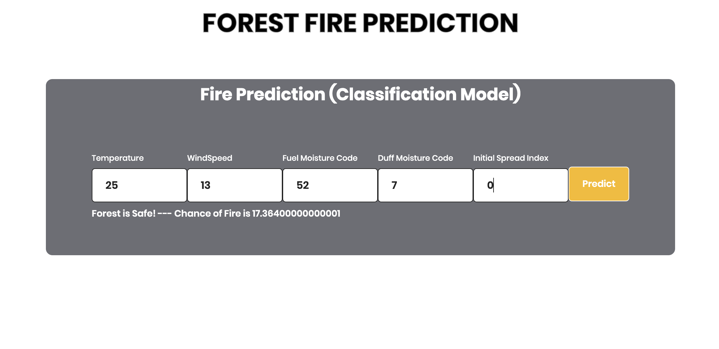
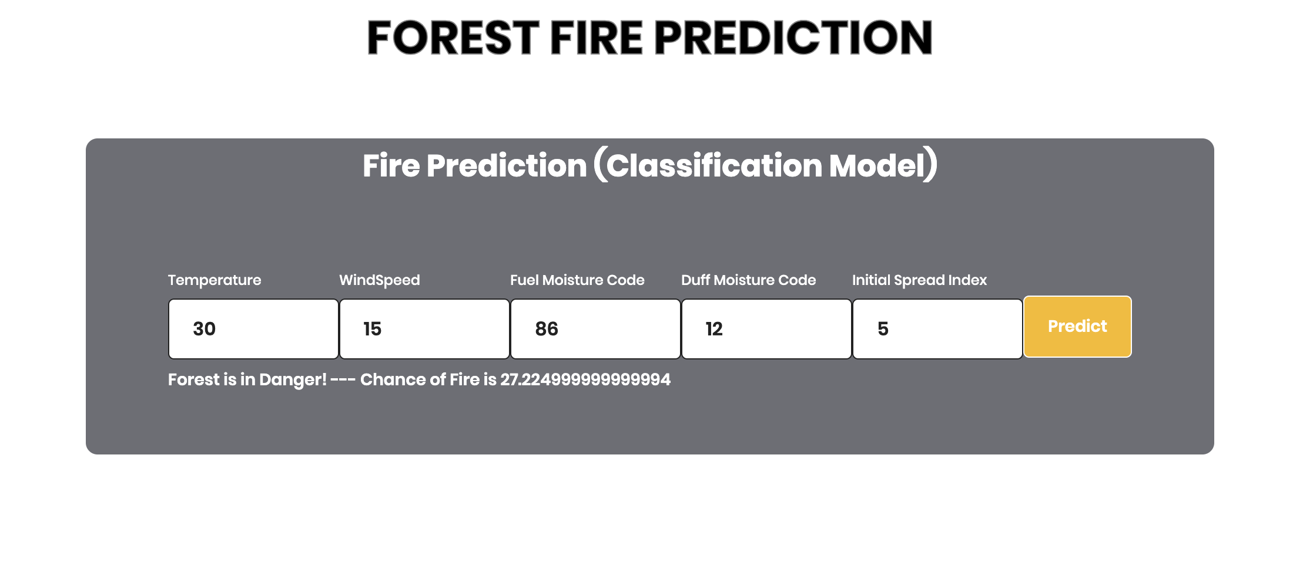
Screenshots

Slide 10

Model deployment (Flask Integration)
Importing the Flask module and creating a Flask web server from the Flask module
Input Data: Users can input environmental parameters such as temperature, wind speed, Fuel moisture code.
Prediction: The input data is processed by our machine learning model, which analyzes the features and predicts the likelihood of a forest fire occurrence.

Slide 11
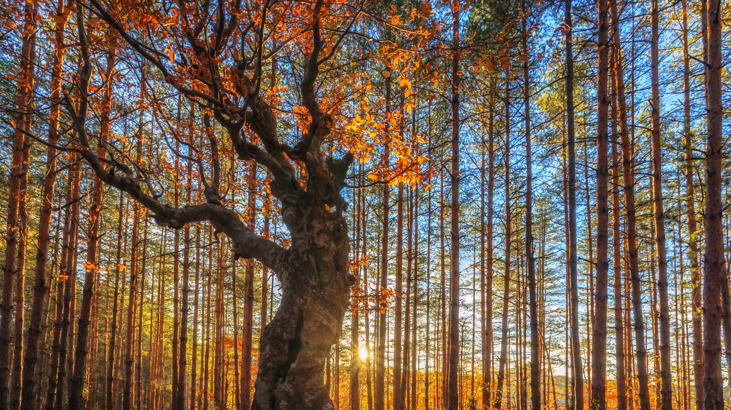
Thank you

